Slide 1
Black Hat Python!
12.1. 2019 Antti Virtanen
@Anakondantti – antti.virtanen@solita.fi

Slide 2
Legal
The information is for educational purposes.
Do not attempt to break into systems or exploit them without a permission!
Legal hacking:
Hackthebox.eu
Shellterlabs.com
Vulnhub

Slide 3
Why? (Fun & Profit ?)
Sometimes the existing tools are not sufficient.
Because it’s fun.
You become a better hacker.

Slide 4
Agenda
Python?
How to use it?
Learning by doing!

Slide 5
Disobey CTF Spoiler alert.

Slide 6
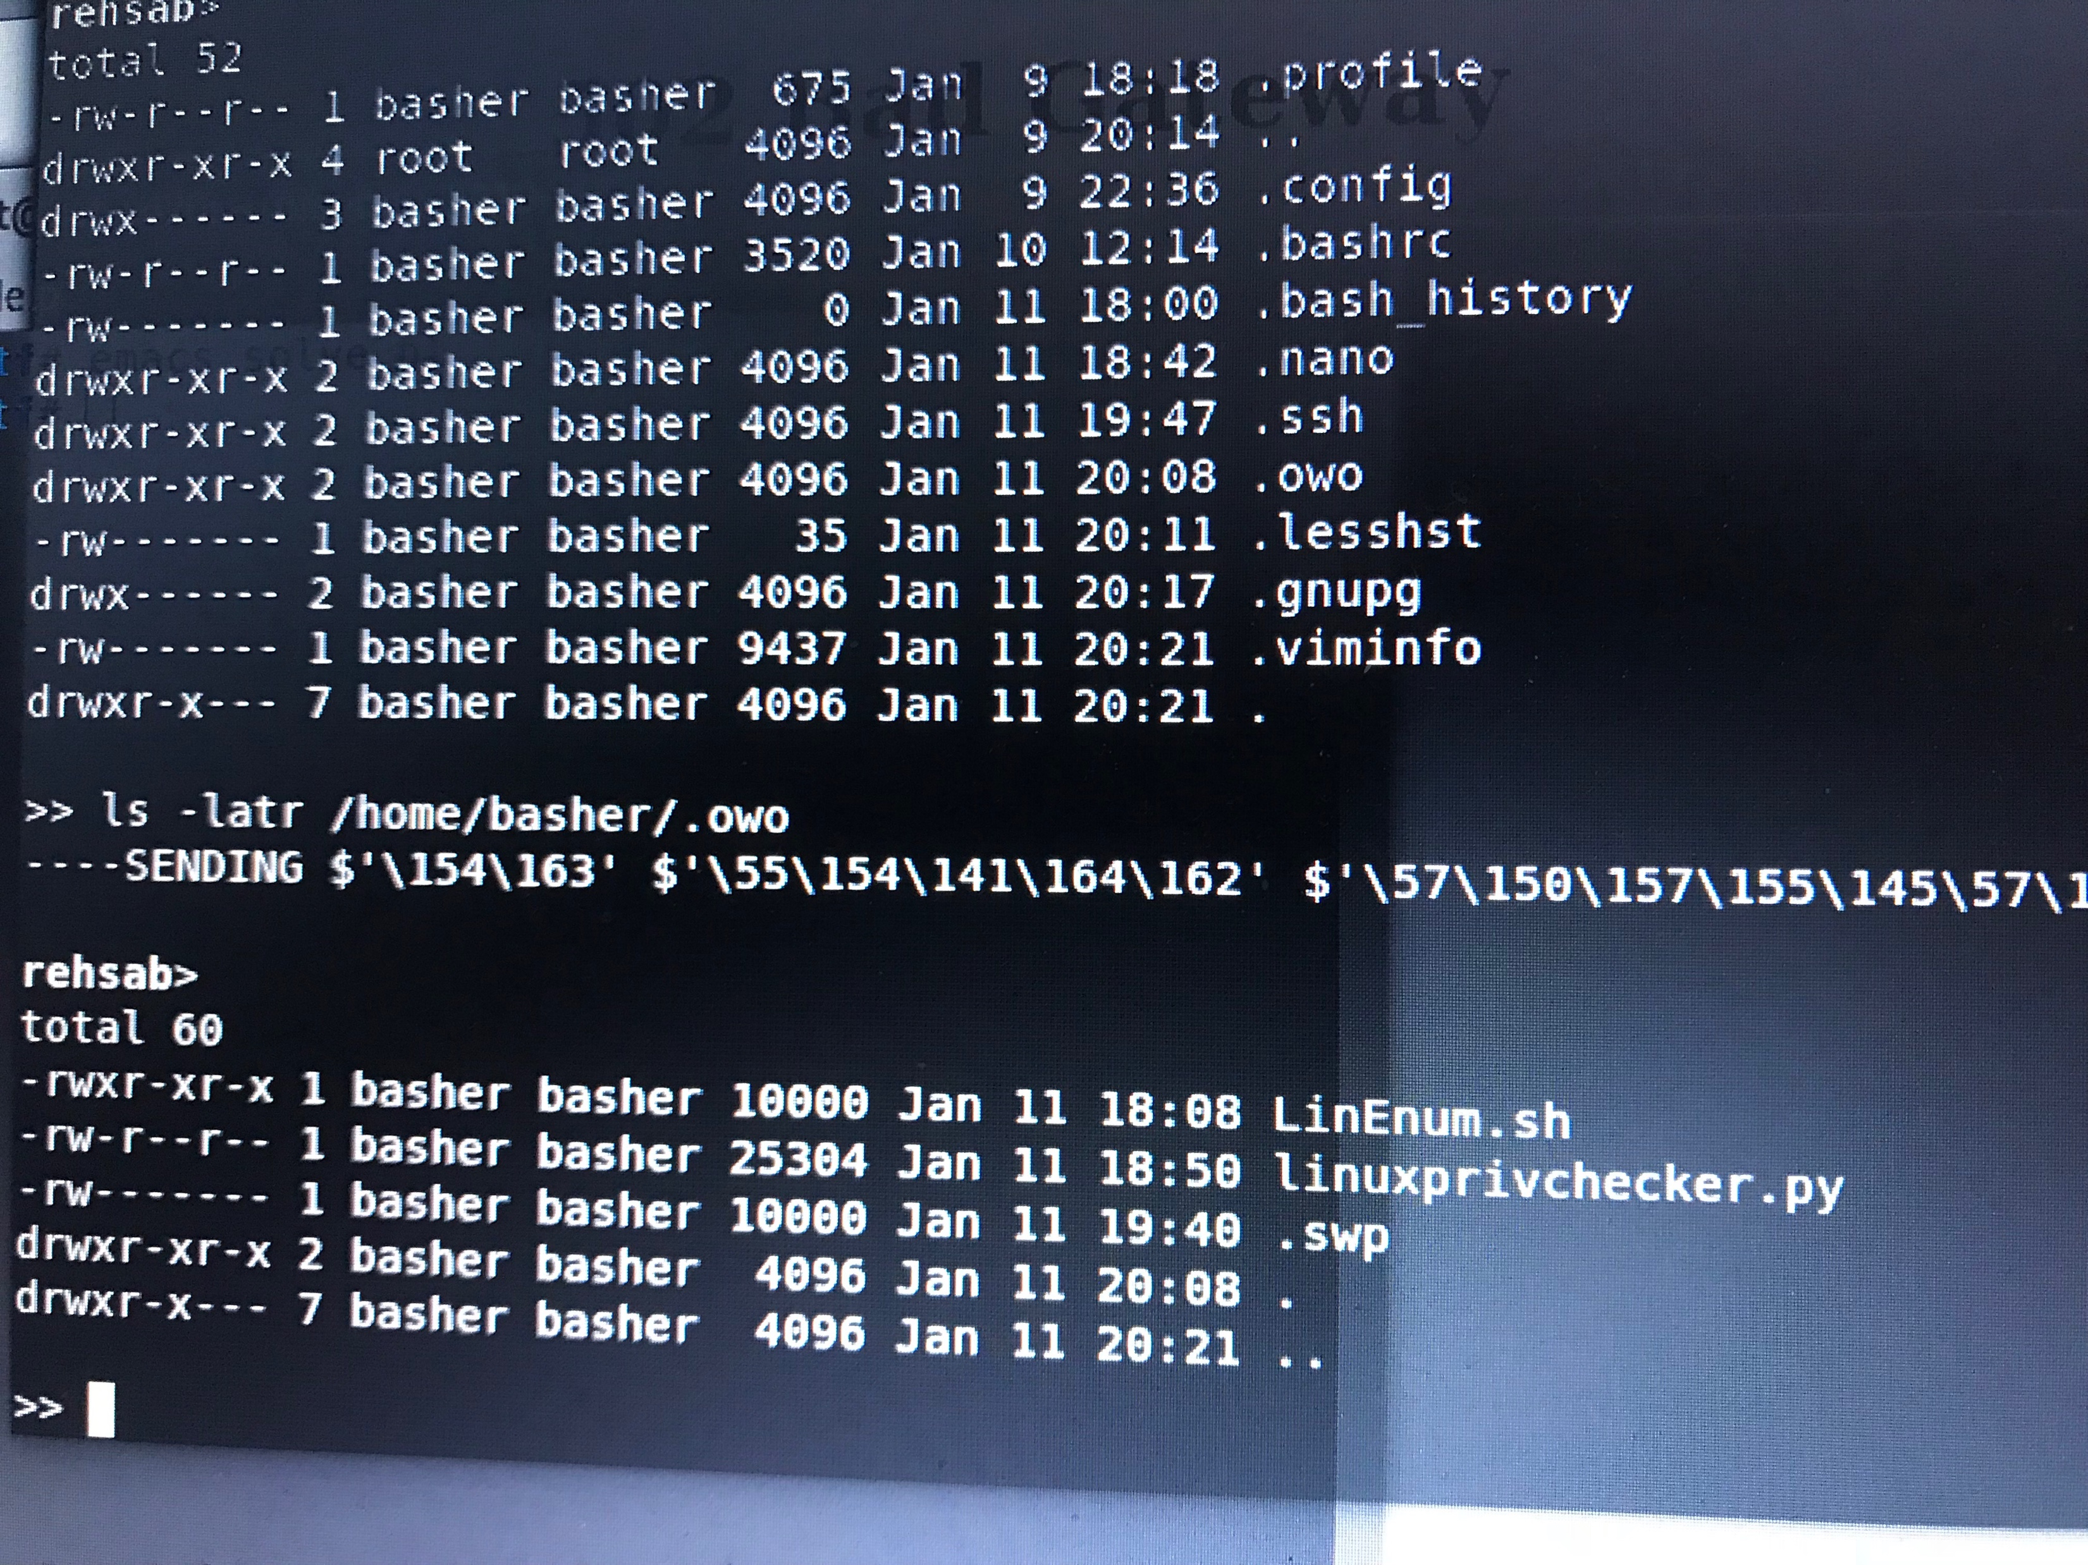
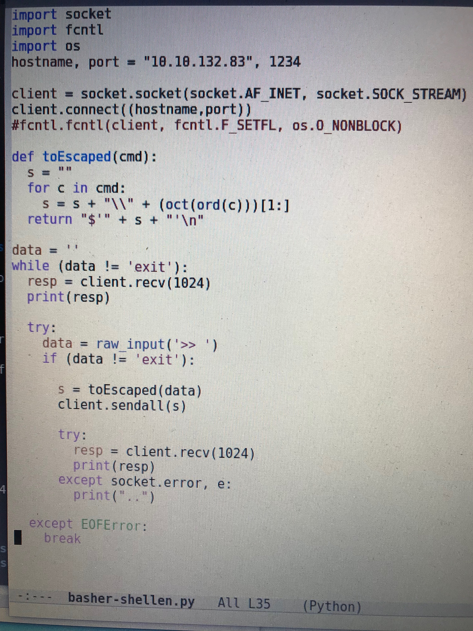
Forget “Professional” software development.
Notes:
The code on the left might have something to do with the Disobey CTF.
(Notice that the mighty owodelta has been there)
(Btw. The script on the left is not the final version, but close)

Slide 7
Quick Python recap

Slide 8
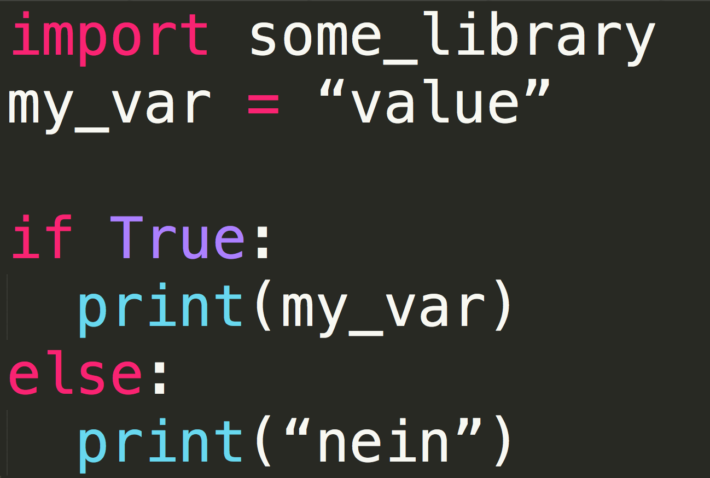
Python is easy!
Notes:
Pretty simple..
Import some libraries
Variable assignment
If statement
Notice that no curly braces, just spaces and indentation used.

Slide 9
Pattern 1: “Shell”

Slide 10
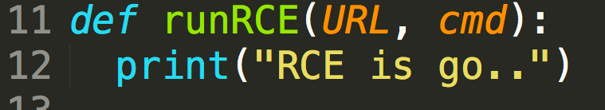
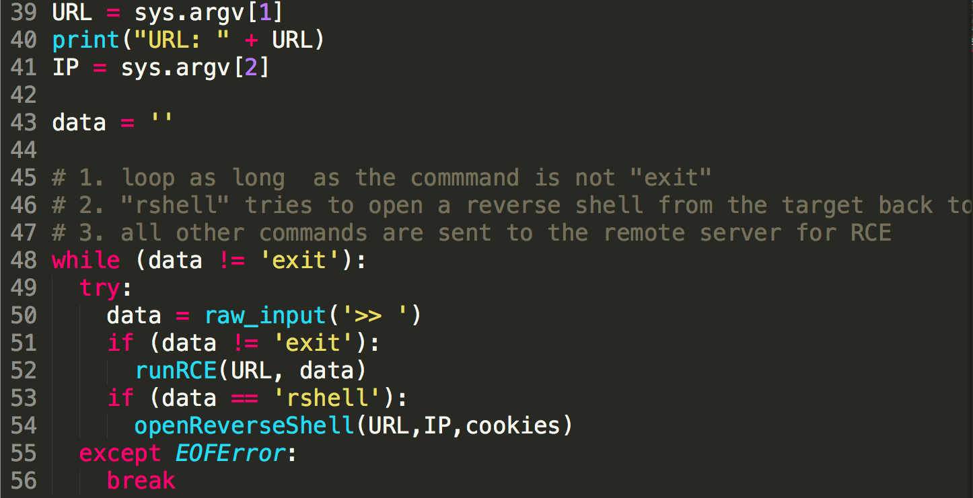
This is how I do it
This changes
Notes:
The main loop is pretty much the same always. I omitted the reverse shell, because it’s not really mandatory and it also may change, depending on the actual vulnerability.
Very simple template, but very handy!

Slide 11
Pattern 2: “Binary pwn”

Slide 12
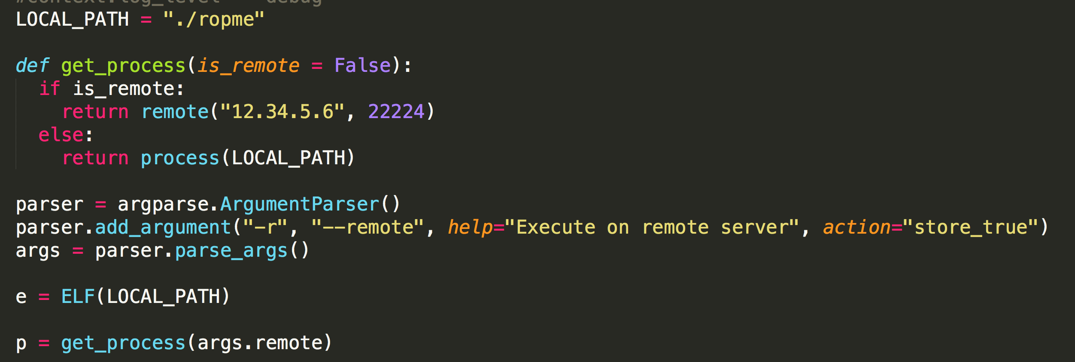
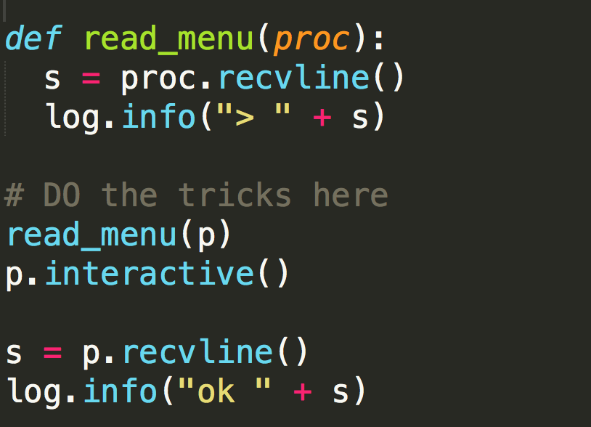
pwntools
This changes

Slide 13
Okay, time to hack.

Slide 14
https://github.com/solita/blackhat-python/
Get stuff from GitHub.
Choose a task.
Start hacking some Python!

Slide 15
Github.com/solita/blackhat-python
12.1. 2019 Antti Virtanen
@Anakondantti – antti.virtanen@solita.fi

Slide 16
Notes:
https://twitter.com/SolitaOy
https://www.facebook.com/Solita
https://www.linkedin.com/company/solita-oy/
https://www.youtube.com/user/SolitaOy

